Slide 1

House Price -Kaggle challenge
Team A-train: Adrian Gillerman
Chaoran Chen
David Corrigan
Denise Sison
Nov 15, 2018

Slide 2
Agenda:
Data preparation
Feature engineering
Model selection
Model stacking
Optimization
Summary

Slide 3
Data preparation
Address Null value fields
Categorize features
Remove outliers
Feature creation
Feature removal

Slide 4

Address Null value fields
Top columns with null values:
Most “NA” values actually mean “No”
Example: PoolQC - Pool quality - NA means “No Pool”
Update all meaningful “NA” to “No” (or numeric 0)
Impute LotFrontage with random sample of filled values
Remaining features with missing data:
Most common category: Electrical,
Zoning, Utilities, Exterior, etc.

Slide 5
Data preparation
Address Null value fields
Categorize features
Remove outliers
Feature creation
Feature removal

Slide 6
Categorize features
Nominal category features - dummy with removal of most common value:
Ordinal category features - digitalize
Example: KitchenQual (Kitchen Quality)
Categories: Po (Poor), Fa (Fair), TA (Typical/Avg), Gd (Good), Ex (Excellent)
Converted to 1, 2, 3, 4, 5
Numeric features - type verification
MSSubClass | MSZoning | Street | Alley | LandContour | LotConfig | LandSlope | Neighborhood | GarageType | SaleType | SaleCondition
BldgType | HouseStyle | RoofStyle | RoofMatl | Foundation | MasVnrType | Heating | CentralAir | LotShape | Utilities | Electrical

Slide 7
Data preparation
Address Null value fields
Categorize features
Remove outliers
Feature creation
Feature removal

Slide 8
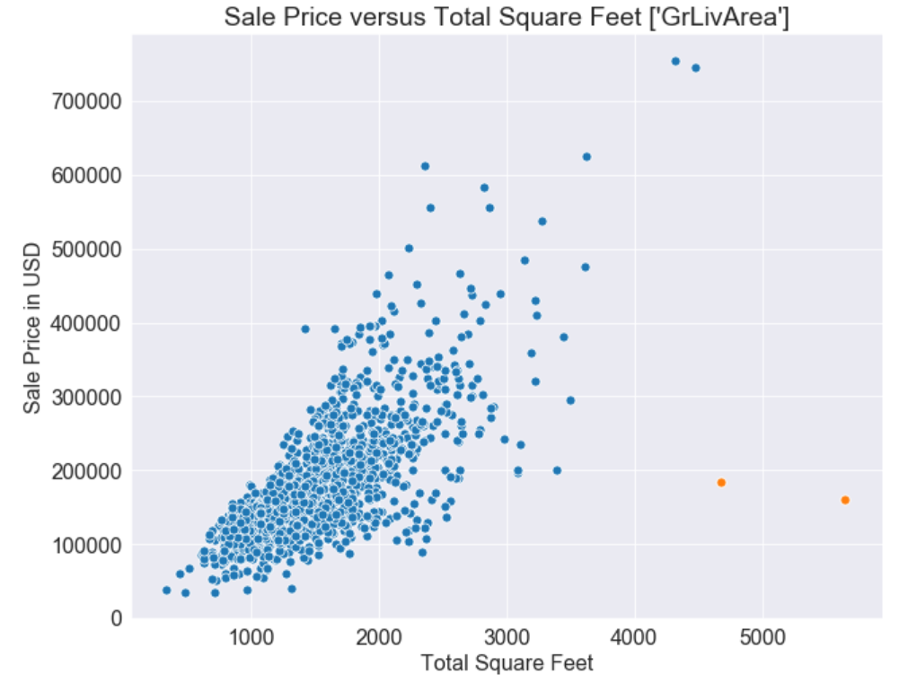
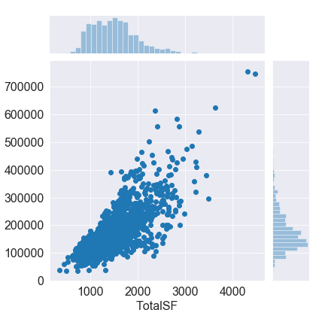
Remove outliers
Two houses with the most SF had average sale price
Data publisher called them unusual sales and recommended removing them
Source: De Cock, D. Journal of Statistics Education, Vol. 9, #3 (2011). http://jse.amstat.org/v19n3/decock.pdf

Slide 9
Data preparation
Address Null value fields
Categorize features
Remove outliers
Feature creation
Feature removal

Slide 10
Add new features
Create BsmtScore
(BsmtType1 * SF1 + BsmtType2 * SF2) / (SF1 + SF2)
Create GarageScore (GarageQual/GarageCond/GarageFinish too correlated)
(GarageCond + GarageQual + GarageFinish) / 3
Define TotalBath
FullBath+BsmtFullBath+0.5*HalfBath+0.5*BamtHalfBath
Convert “Year Built” to “Years Since” concept
YearsAgoBuilt, YearsSinceRemodel, YearsSinceSale
Convert SaleMonth (1-12) to Seasons
Dec-Feb = Winter, Mar-May = Spring, Jun-Aug = Summer, Sep-Nov = Autumn

Slide 11
Data preparation
Address Null value fields
Categorize features
Remove outliers
Feature creation
Feature removal

Slide 12
Feature removal
GarageYrBuilt -- Age of garage: Impossible to reconcile homes without a garage, as this is a numeric, not categorial, value.
Removed. Garage Age should correlate with GarageCond and Garage Qual
Misc Feature -- MiscFeature and MiscValue (value of Misc Features)
Removed MiscFeature since MiscValue contains more info
MSSubClass -- Can be directly inferred by combination of HouseType, BldgType, and YearBuilt. Often highly (>0.9) correlated with HouseType. Removed.

Slide 13
Remove features with less than 4 values
After dummy all the nominal category features, there are 158 columns
19 features had less than 4 values in the training dataset and were removed to reduce statistical noise

Slide 14
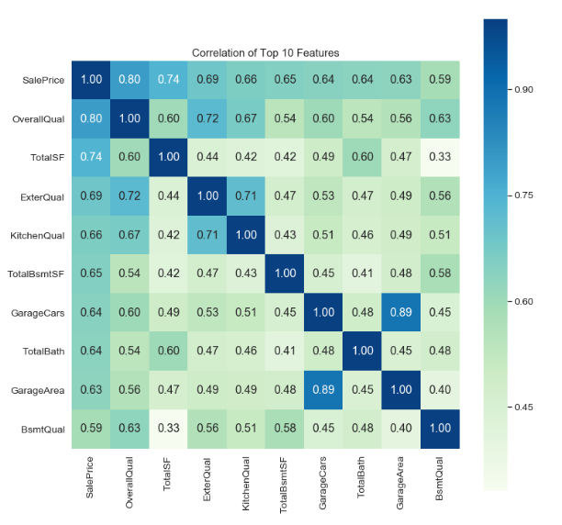
Correlation
Threshold 0.70 is used
MSSubClass_90
SaleCondition_Partial
MSSubClass_190
GarageCond
MSSubClass_80
MSSubClass_50
MSSubClass_45
PoolArea
GarageCars
Fireplaces
MSZoning_FV
RoofMatl_Tar&Grv
TotRmsAbvGrd
MSSubClass_120
MSSubClass_85
MSSubClass_60

Slide 15
Feature engineering
AIC
Lasso
Boost

Slide 16
Feature engineering by AIC
Random selection method -- Set the entire DF as the “current” DF. Choose a feature from the list of all potential candidates. If in the current DF, try removing it. If not in the current DF, try adding it. If this change lowers AIC, keep the change. If not, move to another feature. Stop trying to improve after 200 unsuccessful tries.
Features removed then added back, etc, as DF evolves
Run this 3 times, obtain 3 features lists (~70 features long)
Generate a consensus list of features appearing on all 3 lists (61 total)

Slide 17
Feature engineering
AIC
Lasso
Boost

Slide 18
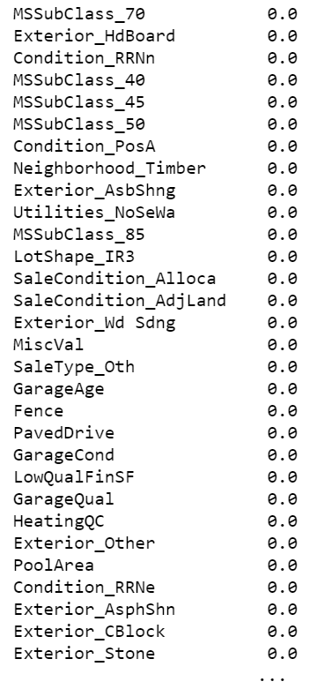
Lasso
Data standardization
Features such as LotArea can have large values
K-fold strategy to find the best lambda
Collect features with coef not equals to zero
69 zero coefs

Slide 19
Feature engineering
AIC
Lasso
Boost

Slide 20
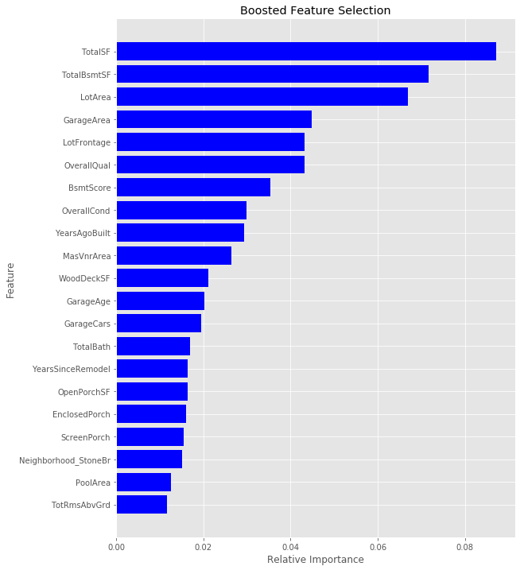
Boost
Based on a modification of Gradient Boosted Trees
Nonlinear feature selection algorithms
Random Forest, XGBoost
Rank and select top important features
Flexible, scalable, straightforward to implement
Computational, memory complexity grows super-linearly w/ train set size
Notes:
Balancing the twin goals of scalability and nonlinear feature selection is still an open problem.
Linear feature selection algorithms such as LARS are highly effective at discovering linear dependencies between features and labels.
However, they fail when features interact in nonlinear ways.
Nonlinear feature selection algorithms, such as Random Forest/XGBoost, can cope with nonlinear interactions.
But their computational and memory complexity typically grow super-linearly with the training set size.
As data sets grow in size, this is increasingly problematic. COSTLY!
In the end, we compared features from the methods we explored and made a conses list of what we deemed was important.
Delete 3 and add 1… better RMSLE train set score.

Slide 21
Model Selection
Linear regression
Ridge regression
Elastic-net regression
Random Forest regression
Gradient Boost regression
Xgboost regression

Slide 22
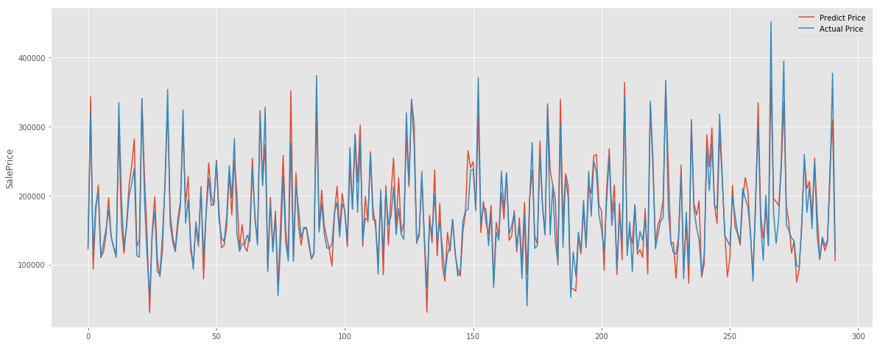
Linear regression
Train score = 0.906
Test score = 0.882
Linear RMSLE = 0.156

Slide 23
Model Selection
Linear regression
Ridge regression
Elastic-net regression
Random Forest regression
Gradient Boost regression
Xgboost regression

Slide 24
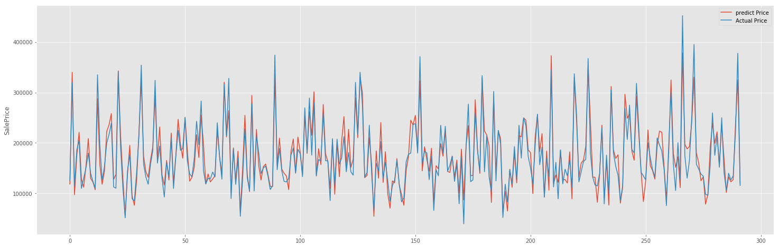
Ridge Regression
Train score = 0.890
Test score = 0.898
Ridge RMSLE = 0.134
Best Lambda = 5.129 (10-fold CV)

Slide 25
Model Selection
Linear regression
Ridge regression
Elastic-net regression
Random Forest regression
Gradient Boost regression
Xgboost regression

Slide 26

Elastic-net Regression
Train score = 0.889
Test score = 0.898
Elastic-net RMSLE = 0.134
Alpha=0.01, l1_ratio=0.522

Slide 27
Model Selection
Linear regression
Ridge regression
Elastic-net regression
Random Forest regression
Gradient Boost regression
Xgboost regression

Slide 28
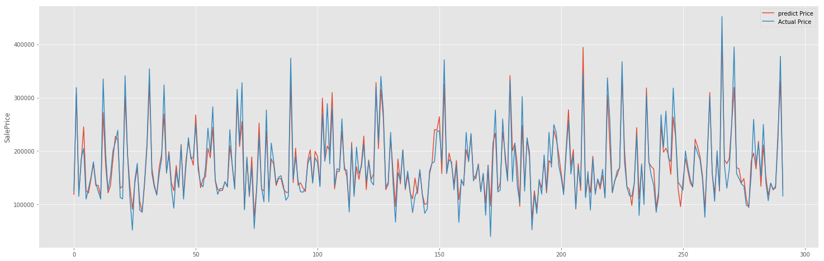
Random Forest Regression
Train score = 0.890
Test score = 0.898
RF RMSLE =0.130
Parameters: Max_features: sqrt
n_estimators: 200
min_samples_split: 2
min_samples_leaf: 1
max_depth: None

Slide 29
Model Selection
Linear regression
Ridge regression
Elastic-net regression
Random Forest regression
Gradient Boost regression
Xgboost regression
Notes:
Boosted Methods… weak learners are “boosted” to become strong learners.

Slide 30
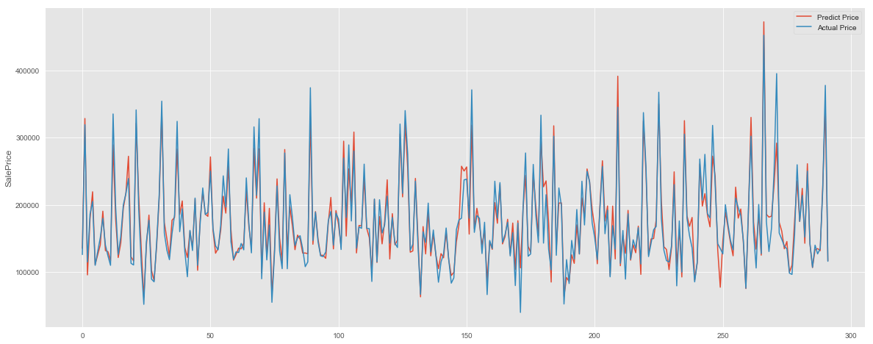
Gradient Boost Regression
Train score = 0.970
Test score = 0.919
GBoost RMSLE = 0.122

Slide 31
Model Selection
Linear regression
Ridge regression
Elastic-net regression
Random Forest regression
Gradient Boost regression
Xgboost regression

Slide 32
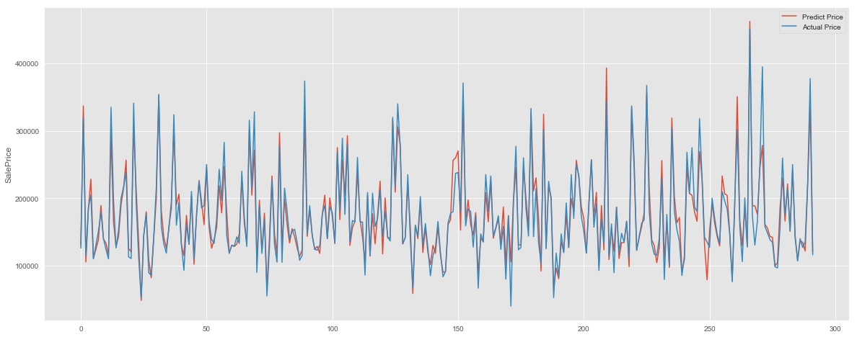
Xgboost Regression
Train score = 0.983
Test score = 0.917
Xgboost RMSLE = 0.121
Notes:
Summary: test all, which model should we use?

Slide 33
Model Stacking
Perform grid search, intervals of 5, from 0 - 20
For loops of integers i, j, k, etc
Each value is an integer representing fraction of an individual model
When i + j + k == 20:
StackedScore = i * model1 + j * model2 + k * model3 / (20)
Reveals what combination of models produces the best result
Ridge hurt model stacking, linear helped, despite a better RMSLE for the ridge over the linear

Slide 34
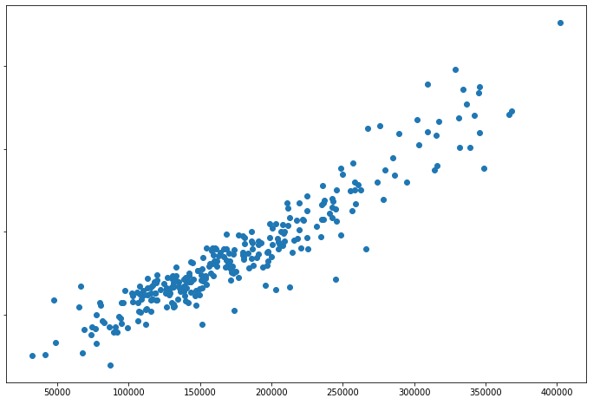
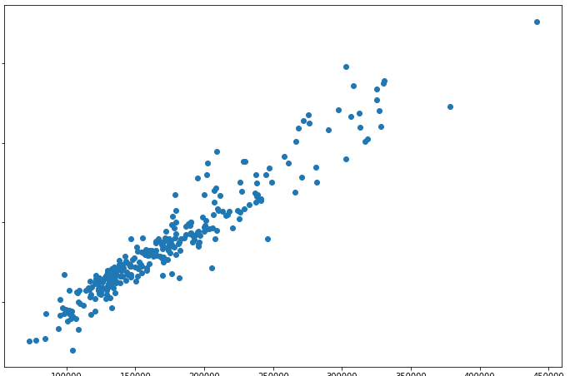
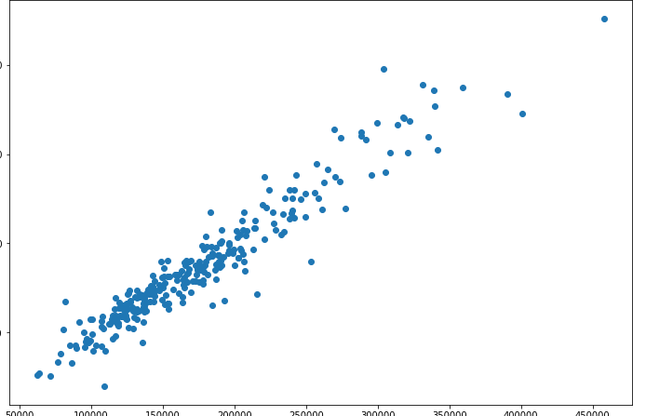
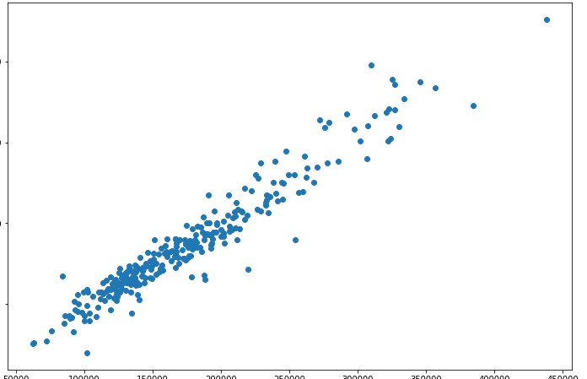
Model Stacking - Graphically
Linear
Random
Forest
Actual Value
Gradient
Boost
Stacked
Model
Predicted Value

Slide 35
Model Stacking - W/O feature creation/removal
20% Linear + 20% Random Forest + 24% Xgboost + 36% Gradient Boosting
Score evaluation
Overfitting? In this run, we had a large starting feature list (from xgBoost); modified it with the other methods (AIC/Ridge) to find the lowest Test score
Test Location | RMSLE Score
Local | 0.1126
Kaggle | 0.1301
Notes:
Kaggle score not as good…. Assumption… overfitting. Optimize local score.. Hurt the model aka OVERFITTING

Slide 36
Model Stacking - With feature creation/removal
Here, we generated 1 list (consensus 61 features from random AIC), did not attempt to optimize the test score. Worse test score, better Kaggle score.
Stacked grid search: 40% gBoost, 25% Linear, 35% RandomForest
Score evaluation
Test Location | RMSLE Score
Local | 0.122
Kaggle | 0.118

Slide 37
Summary
Conclusion:
1+1 !=2 -- stacking with linear model improved score, even though it had a higher RMSLE than gradient boosting and random forest
Overfitting data is problematic, even when splitting train/test groups
Understanding your features can help you to improve a model
To be continued:
Consider features which may not be normally distributed
Consider if some “ordinal” features may work better as non-numeric
Try more combination of features
Try additional model algorithms

Slide 38

Thanks!

